Slide 1
UNFPA Gen AI-Powered Evaluation Strategy
An introductory slide highlighting UNFPA's vision and approach to leveraging generative AI to transform its evaluation function through ethical and responsible implementation.

Slide 2

https://www.menti.com/aln1jrqyqbcm

Slide 3
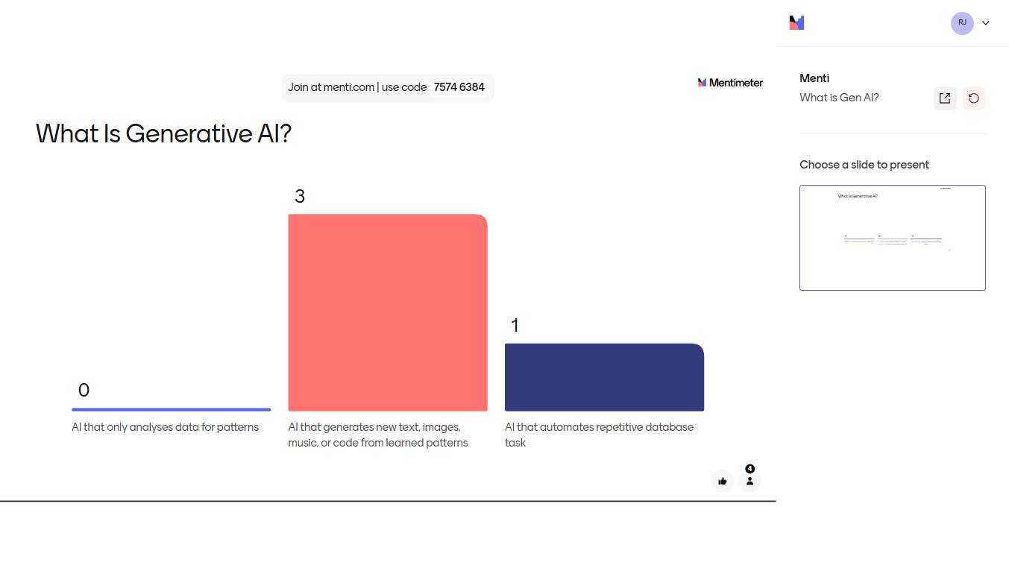

Slide 4
What Is Generative AI?
A creative AI: It’s a kind of artificial intelligence that doesn’t just analyse data—it generates brand-new content.
Learns patterns: By studying huge amounts of existing text, images, code, or audio, it learns the “style” and structure of that content.
On-demand creation: You give it a prompt (“Write me a poem about M&E”; “Draw a rainforest at sunset”), and it produces original text, images, music, or even code.
Why it matters: Automates creative and repetitive tasks, sparks new ideas, fills in gaps so your team can focus on strategy, insight, and human judgment.
All Generative AI is AI, but not all AI is Generative. Traditional AI helps you understand data—Generative AI helps you produce new content

Slide 5



Background and Challenges
Traditional evaluations at risk of obsolescence
UNFPA's commitment to responsible AI
Risks and challenges with GenAI integration
Evaluation practices must evolve to keep up with the digital transformation, or risk becoming outdated and ineffective.
UNFPA is dedicated to a human-led, ethically grounded approach to leveraging GenAI in its evaluation function.
Integrating GenAI introduces new ethical, methodological, and organizational risks that must be carefully navigated.
UNFPA recognizes the urgent need to adapt its evaluation practices to the digital age, while proactively addressing the risks and challenges associated with GenAI integration. The organization's strategic approach prioritizes responsible, human-led oversight to ensure the credibility and impact of its evaluations.

Slide 6



Why GenAI Now?
AI is revolutionizing knowledge work
UN 2.0 Digital Transformation demands smarter evaluation
SDG acceleration needs faster, scalable, ethical evaluations
Generative AI models like GPT-3 and DALL-E have demonstrated transformative capabilities in areas like content creation, data analysis, and task automation since 2022-23.
The UN's 2.0 Digital Transformation strategy calls for integrating emerging technologies like AI to modernize and streamline operations, including the evaluation function.
To achieve the Sustainable Development Goals by 2030, evaluations must become more efficient, comprehensive, and responsible in order to drive faster decision-making and policy adjustments.
UNFPA recognizes the transformative potential of generative AI to enhance its evaluation function, while remaining committed to upholding ethical principles and human oversight in the process.

Slide 7



Strategy Development Process
Needs assessment conducted
Consultations with key stakeholders
Lessons to inform global partners
UNFPA conducted a comprehensive needs assessment between June and August 2023 to understand the opportunities and challenges of integrating GenAI into its evaluation function.
UNFPA engaged in extensive consultations with the Independent Evaluation Office (IEO), Regional Monitoring and Evaluation teams, Information Technology and Systems Office (ITSO), Legal, and Ethics departments to gather input and buy-in.
The insights and lessons learned from this process will be shared with UNEG (UN Evaluation Group), EvalPartners, and UNFPA's Global South partners to foster a collaborative and coherent approach to responsible GenAI integration in evaluations.
UNFPA's strategic development process for its GenAI-Powered Evaluation Strategy has been a comprehensive and inclusive effort, ensuring that the initiative is informed by diverse stakeholder perspectives and aligned with global best practices. This collaborative approach positions UNFPA as a leader in driving responsible innovation in the evaluation field.

Slide 8


Vision and Dual Goals
Strengthen UNFPA evaluation function ethically
Lead global dialogue on responsible GenAI in evaluations
Integrate GenAI responsibly to enhance efficiency, quality, and credibility of UNFPA evaluations while upholding ethical principles and human oversight.
Position UNFPA as a thought leader in the ethical application of emerging technologies, sharing lessons and building capacities particularly in the Global South.
By pursuing these dual goals, UNFPA aims to champion the responsible and transformative use of GenAI in the evaluation field, strengthening its own practices while influencing global norms and practices.

Slide 9
How AI Enhances Evaluation
Automates Evidence Synthesis
Supports Data Collection & Analysis
GenAI tools can rapidly review and extract key insights from large volumes of evaluation data, reports, and literature, accelerating the synthesis of evaluation evidence.
GenAI chatbots can conduct interactive interviews, streamlining data collection from stakeholders. Advanced language models can automate coding and analysis of qualitative data, such as open-ended survey responses.
Accelerates Report Generation
Enhances Evaluation Quality Assurance
GenAI can draft initial evaluation report sections, such as the executive summary and recommendations, reducing the time and effort required for report writing.
GenAI tools can scan evaluation reports, identifying potential issues, biases, or gaps, enhancing the rigor and quality of evaluations, supplementing human review processes.

Slide 10
Methodological Challenges
Matching diverse GenAI methods
Evaluating which GenAI techniques are most suitable for specific evaluation needs, such as qualitative analysis, data synthesis, or report generation.
Balancing speed gains
Ensuring that the efficiency and timeliness benefits of GenAI do not compromise the accuracy, credibility, and utility of evaluation outputs.
Ensuring explainability
Addressing the 'black box' nature of many GenAI models to ensure transparency and accountability of the evaluation process.
Preventing automation bias
Strengthening data triangulation and human-in-the-loop checks to mitigate the risk of over-reliance on GenAI outputs.
Identifying and eliminating biases
Proactively detecting and addressing any biases or inequities introduced by the underlying data or GenAI algorithms used in the evaluation.

Slide 11
Ethical & Organizational Risks
Avoid extractive AI; align with human rights and environmental care
Ensure AI systems are not exploitative and respect human rights and environmental sustainability.
Guard against algorithmic discrimination and unfair outcomes
Implement robust bias testing and mitigation strategies to prevent AI-driven biases and unfair treatment.
Protect data privacy, copyright, and IP in cloud environments
Implement strong data governance and security measures to safeguard sensitive information and intellectual property.
Retain human accountability for all AI outputs
Maintain transparency and human oversight to ensure accountability for decisions and actions driven by AI.
Prevent erosion of evaluators' critical thinking
Ensure AI augments and empowers evaluators, not replaces their analytical and creative abilities.
Manage change: capacity gaps, resistance, inter-agency coordination
Address organizational and cultural challenges, including skills gaps, change management, and cross-agency collaboration.

Slide 12
Principles for GenAI Evaluation
Demand-driven
Only use GenAI when it adds real value to the evaluation process.
Diversification
Continuously explore and integrate new GenAI tools to enhance evaluation effectiveness.
Quality & Credibility
Ensure rigorous, transparent AI-assisted analysis to maintain the credibility of evaluation outcomes.
Utility
Deliver timely, relevant, and accessible evaluation insights through GenAI-powered tools.
Human-rights based
Leverage GenAI in a manner that upholds human rights principles and leaves no one behind.
Capacity building
Empower evaluation stakeholders to effectively utilize GenAI technologies and solutions.

Slide 13


Ethical & Organizational Risks
Potential Harms
Mitigation Strategies
Individuals: Data breaches, misrepresentation, digital divide
Enforce encryption, access controls, and regular compliance audits; embed human-in-the-loop checks; require AI ethics disclosures
Groups: Biased analyses reinforcing inequities
Document all AI processes; declare AI use in reports; define mandatory human review points and escalation paths
Communities: Trust loss from opaque or unfair AI use
Monitor user feedback and set up rapid issue-resolution processes
Institutions: Reputational damage, flawed scaling
Select energy-efficient AI models; measure and minimize environmental footprint
Ecosystems: High carbon footprint and resource strain
Ensure coherence and shared learning across the UN system; coordinate GenAI practices across UN entities
*This data is generated based on the provided context.

Slide 14
Selecting GenAI Tools
Assess availability & fit
Assess resource availability, legal/IT/procurement fit, and UNFPA architecture alignment
Evaluate security & costs
Evaluate security features, data-privacy protocols, start-up and maintenance costs
Estimate optimization potential
Estimate optimization potential, required training, and scalability
Prioritize low-code solutions
Prioritize low-code/no-code Google ecosystem solutions with ITSO partnership
Continuously scan for new tools
Continuously scan for emerging tools and evolving user needs

Slide 15


Ethical Guidelines for Consultants and Companies
Prior approval required for any AI tool use
Full transparency and manual validation of AI outputs
Respect UNFPA's human rights, privacy, and non-discrimination standards
UNFPA will evaluate and approve all proposed AI tools before consultants or companies can use them in UNFPA evaluations
Consultants and companies must provide complete documentation of AI processes and have a human expert validate all AI-generated outputs
AI-powered evaluations must adhere to UNFPA's ethical principles, including protecting individual privacy and avoiding biased or discriminatory practices
These ethical guidelines ensure responsible and accountable use of AI in UNFPA evaluations, prioritizing transparency, validation, and alignment with the organization's core values and principles.

Slide 16
Potential Harms at Different Levels
Breach of personal data privacy
Use of GenAI could lead to unauthorized access or leakage of sensitive personal information collected during evaluations, violating individual rights to privacy.
Algorithmic discrimination against minorities
If not carefully designed, GenAI models could exhibit biases and make decisions that unfairly disadvantage vulnerable or marginalized groups.
Loss of trust in evaluation outcomes
Over-reliance on GenAI or transparency issues around its use could erode stakeholder confidence in the credibility and fairness of evaluation findings.
Reputational damage
Misuse of GenAI or associated scandals could tarnish UNFPA's reputation as a leader in ethical, responsible evaluation practices.
Carbon footprint of AI technologies
The energy-intensive nature of running large language models and AI infrastructure could contribute to UNFPA's environmental impact if not properly managed.

Slide 17







Risk Mitigation Strategies
Strong Encryption and Privacy Compliance
Human Oversight for Every AI-Assisted Output
Ethical Compliance Audits
Transparency and Sustainability in Tool Selection

Slide 18




Risk Mitigation Measures
Encrypt and protect sensitive evaluation data
Transparently document AI use and methodologies
Use strong encryption and access controls to safeguard confidential information, such as personal data, collected during evaluations.
Maintain detailed records of how and where AI tools are applied, and clearly communicate the limitations and caveats of AI-assisted analysis in evaluation reports.
Validate all GenAI outputs with human oversight
Prefer energy-efficient, ethical AI systems
Implement a rigorous process to cross-check and validate all outputs generated by AI systems before incorporating them into evaluation findings or reports.
Prioritize the use of AI systems that adhere to UNFPA's environmental and human rights standards, minimizing the carbon footprint and negative social impacts of AI deployment.
By implementing these risk mitigation measures, UNFPA can harness the benefits of GenAI while upholding its commitment to ethical, responsible, and transparent evaluation practices.

Slide 19
Principles Underlying GenAI Use
Do No Harm
Ensure the use of GenAI does not cause harm to individuals, groups, communities, institutions, or the environment.
Transparency and Explainability
Document data collection, cleaning, and labeling processes. Clearly explain GenAI and NLP tasks, methods, and tools used.
Fairness and Inclusion
Design and deploy GenAI models to ensure fairness, non-discrimination, and inclusivity, avoiding biases.
Data Privacy and Protection
Implement strict measures to protect personal and sensitive data, aligning with UNFPA IT guidelines and policies.
Human Oversight and Responsibility
Maintain critical thinking and be responsible for the validity and quality of evaluation outputs, even when using GenAI.
Environmental Sustainability
Assess and monitor the carbon footprint and resource use of GenAI tools, adopting sustainable computing practices.

Slide 20
GenAI Key Use Cases for Evaluation
Document Review
Summarizing large reports and extracting key insights to inform the evaluation
Interview Analysis
Thematic clustering and sentiment analysis of interview transcripts
Evidence Synthesis
Triangulation and synthesis of data from multiple sources
Drafting
Generating draft text for background sections and other report components
Visualization
Creating mind maps, flowcharts, and other visual aids to communicate findings
Sentiment Analysis (Experimental)
Analyzing stakeholder perceptions and emotions (with caution)

Slide 21
Ethical Use Guidelines for Consultants and Vendors
Obtain prior approval
Consultants must obtain explicit written approval from the IEO Director before utilizing AI tools in their evaluation work.
Disclose AI tool use
Consultants must be transparent and declare the use of AI tools, specifying the nature of AI usage. Only IEO-vetted AI tools can be used.
Validate outputs manually
Consultants must diligently check the accuracy of AI-generated results and assume full responsibility for their reliability and validity.
Follow UNFPA ethical principles
Companies providing evaluation support to UNFPA must uphold and adhere to the Principles for the Ethical Use of Artificial Intelligence in the UN System.
Allow verification and transparency
Companies must implement processes to validate the results generated by AI analyses and provide a clear description of the methodology employed.

Slide 22






GenAI Use Cases by Phase
Preparatory
Design
Field
Reporting
Dissemination
Quality Assurance
Auto-draft ToRs; CRM-based consultant recruitment.
Automated evidence search, summarization, portfolio synthesis.
AI-assisted qualitative coding, transcription, quantitative trends.
Draft generation, readability enhancements, feedback management.
Inclusive translation, audience targeting, auto-slides.
Streamlined QA workflows; enhanced triangulation.

Slide 23




Prioritized User Needs Across Evaluation Phases
Data Analysis
Qualitative, quantitative, and transcription support
Dissemination
Evidence Synthesis
Accessibility
Searching, retrieving, and summarizing data
Enhancing report readability and usability
Report Drafting
Assisting with report generation and editing
ToR Drafting
Translation
Generating initial Terms of Reference
Converting reports to diverse languages and formats
Preparatory

Slide 24



Restrictions on GenAI Use
No AI-driven evaluation findings without human validation
No AI use for sensitive topics like GBV conclusions
No uploading of confidential UNFPA data into public AI models
All AI-generated outputs must be reviewed and validated by human evaluators before being included in final evaluation reports.
Due to the sensitive and personal nature of gender-based violence data, AI tools will not be used to analyze or draw conclusions related to GBV findings.
To protect the privacy and confidentiality of UNFPA data, no internal or evaluation-related information will be uploaded to publicly available AI language models.
These restrictions on GenAI use demonstrate UNFPA's commitment to responsible, human-led integration of emerging technologies, prioritizing ethical principles, data privacy, and the credibility of its evaluation function.
Notes:
Important

Slide 25




Evaluation Types for Initial Pilots
Centralized evaluations
Thematic evaluations
High-profile, corporate-level evaluations managed directly by the UNFPA Independent Evaluation Office (IEO)
In-depth evaluations of a specific UNFPA thematic area or cross-cutting issue
Corporate evaluations
Mid-term reviews
Organization-wide evaluations of UNFPA's strategic plans, policies, and institutional effectiveness
Evaluations conducted at the midpoint of a program cycle to assess progress and course-correct
These four evaluation types have been identified as initial pilots for incorporating GenAI tools and methods, leveraging their scope and potential for high-impact to drive responsible innovation within the UNFPA evaluation ecosystem.

Slide 26



Monitoring & Evaluation
Centralized Evaluations
Decentralized Evaluations
50% of centralized evaluations responsibly and ethically integrate GenAI solutions (output indicator), 40% demonstrate optimized processes (efficiency) and products (quality) (outcome indicator)
25% of decentralized evaluations responsibly and ethically integrate GenAI solutions (output indicator), 20% demonstrate optimized processes and products (outcome indicator)
National Capacity Building
Joint and System-wide Evaluations
Lead at least 2 GenAI evaluation capacity building events, achieve at least 1 strategic multi-stakeholder partnership focusing on the Global South
10% of joint and system-wide evaluations responsibly and ethically integrate GenAI solutions (output indicator), 5% demonstrate optimized processes and products (outcome indicator)
Notes:
The monitoring and evaluation framework for the GenAI-powered Evaluation Strategy includes a comprehensive set of output and outcome indicators to track the responsible and ethical integration of GenAI solutions across centralized, decentralized, and joint/system-wide evaluations, as well as the progress in building national evaluation capacity, particularly in the Global South.

Slide 27
Organizational Roles and Responsibilities
Evaluators
Managers
Cross-check, validate, and supervise GenAI outputs.
Enforce ethical compliance across evaluations.
IT Support
IEO Leadership
Maintain secure GenAI infrastructure.
Provide training, update policies, and position UNFPA globally on responsible GenAI use.

Slide 28


Monitoring and Evaluation Framework (Annex 1)
Indicator
Target (Year)
% of centralized evaluations supported by GenAI
50% (2025)
% of decentralized evaluations using GenAI methods
25% (2026)
% of UN evaluations incorporating GenAI elements
10% (2026+)
Number of strategic partnerships with Global South on GenAI
2 (2026+)
*UNFPA GenAI-Powered Evaluation Strategy

Slide 29
Prioritized User Needs Across Evaluation Phases
Preparatory Phase
Design Phase
Fieldwork Phase
Use GenAI to draft ToRs by summarizing national SRHR strategies, key policies, and past evaluation findings
Leverage GenAI to synthesize existing evidence, map linkages between outputs, and identify gaps for evaluation questions
Deploy GenAI for interview/FGD transcription, auto-coding, and sentiment analysis on survey open-ends
Reporting Phase
Dissemination Phase
Generate draft narrative sections of evaluation reports using GenAI, and simplify technical language for non-technical stakeholders
Automate translation, accessibility formatting, and user-segmented briefs/newsletters with GenAI support

Slide 30
“GenAI is a tool, not a decision-maker. Human wisdom, ethics, and critical oversight must always lead.”
UNFPA

Slide 31
Selecting GenAI Tools
Assess resource availability
Evaluate the availability of necessary resources, including financial, human, and technological, to support the implementation and maintenance of GenAI tools.
Evaluate legal and IT requirements
Ensure the selected GenAI tools align with UNFPA's legal and IT policies, as well as any applicable regulations and data privacy standards.
Prioritize procurement fit
Assess the compatibility of GenAI tools with UNFPA's procurement processes and procedures to enable efficient and compliant acquisition.
Assess UNFPA IT architecture alignment
Evaluate the integration of GenAI tools with UNFPA's existing IT infrastructure and systems to ensure seamless implementation and data management.
Evaluate key solution features
Assess the specific capabilities and functionalities of GenAI tools to ensure they meet the identified evaluation needs and requirements.
Prioritize security and data privacy
Ensure the selected GenAI tools have robust information security features and comprehensive data privacy protocols to protect sensitive evaluation data.
Consider cost implications
Evaluate the start-up, continuation, and maintenance costs associated with the implementation and use of GenAI tools to ensure long-term sustainability.
Estimate optimization potential
Assess the potential of GenAI tools to optimize specific evaluation processes or workflows, and the anticipated benefits in terms of efficiency and effectiveness.
Identify and mitigate risks
Carefully assess the potential risks and harms associated with the use of GenAI tools across various use cases, and develop appropriate mitigation strategies.
Prioritize low-code/no-code solutions
Leverage the Google ecosystem to explore and test the feasibility of developing no-code or low-code GenAI solutions that meet UNFPA's evaluation needs.

Slide 32
Roles & Responsibilities
Internal Stakeholders
External Stakeholders
- IEO Director: principle approval, ethics oversight - AI Specialists: tool development, vetting, ethics alignment - Evaluation Managers: integration, quality assurance - M&E Advisors: decentralized training and support - ITSO/PSD/TD: infrastructure, policy, risk management
- UNEG and Meta-evaluation Experts: standard-setting - AI Ethics Advisors: ongoing risk guidance - Global South Partners: capacity building and advocacy
Coordinating Mechanisms
Capacity Building
- AI Advisory Body (Dec '23): inclusivity, accountability, data governance - Joint working groups and communities of practice - Shared learning and knowledge exchange across UN entities
- GenAI literacy training for all IEO staff - Targeted upskilling for managers, analysts, quality assurance leads, and external contractors - Partnerships and collaborations among UN agencies on digital transformation

Slide 33


Slide 34
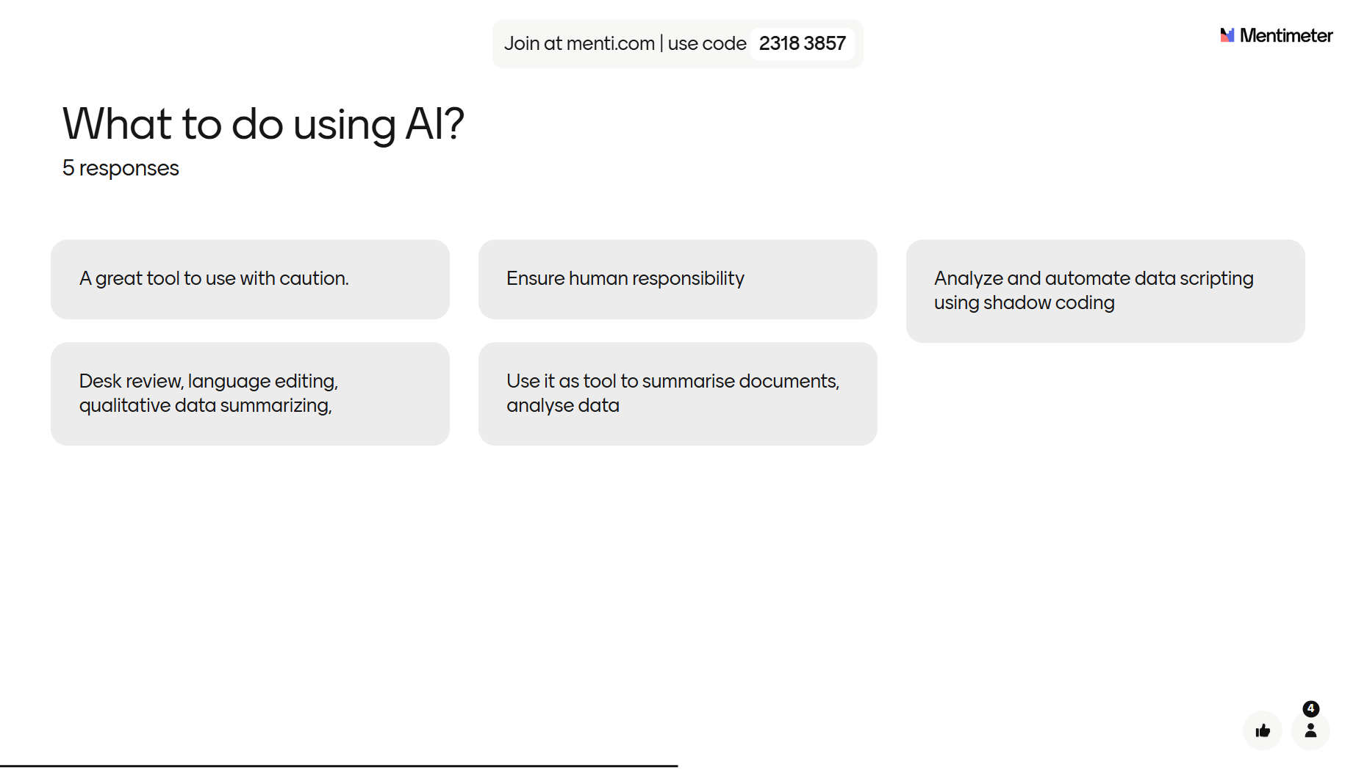

Slide 35
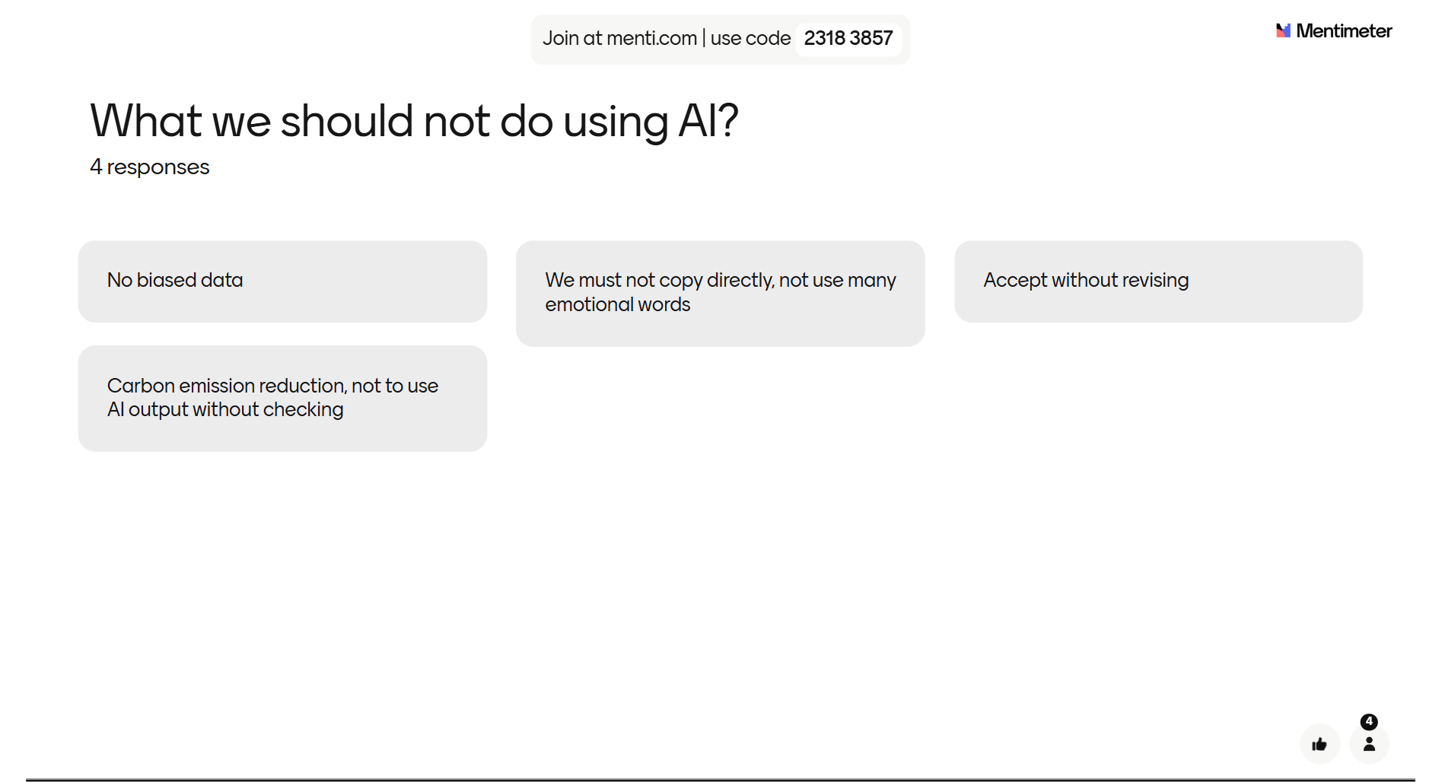

Slide 36
Do’s and Don'ts Summary
✅ Obtain prior written approval from the IEO Director before using any AI tool in your design work ​
✅ Use only IEO-vetted GenAI platforms (per Annex 3) ​
✅ Declare in your ToR and design docs which AI tool you used and for which task ​
✅ Validate every output manually: check facts, correct hallucinations, ensure relevance ​
✅ Keep a human-in-the-loop: AI drafts or suggests, but humans finalize logic models, questions, risk checklists ​
✅ Adhere to UNFPA’s data-security and privacy policies—never upload personal or sensitive data to public models ​
✅ Document your prompts, input sources, and how you incorporated the AI-generated text into the final design ​
✅ Apply ethical principles (transparency, fairness, non-discrimination) when crafting evaluation questions or stakeholder maps
❌ Use AI without explicit written approval ​
❌ Upload confidential UNFPA data (e.g., participant lists, raw survey responses) into public LLMs ​
❌ Rely on AI to draw final conclusions or write sensitive sections (e.g., GBV ethics, human-rights analysis) without human oversight
❌ Skip the accuracy check - never accept AI text as-is, since models can hallucinate or introduce bias ​
❌ Fail to declare AI use—omitting disclosure violates the AI usage clause ​
❌ Overlook bias mitigation - do not ignore signs of stereotyping, under-representation, or discriminatory language in AI outputs
❌ Disregard copyright or IP: do not pass off AI-generated text that mirrors proprietary sources without proper adaptation and attribution ​
❌ Use AI as a black-box: avoid any “fire-and-forget” approach; maintain full transparency on how AI shaped your design artifacts ​

Slide 37



Next Steps & AI Clauses
Obtain written IEO approval
Validate AI outputs
Embed methodology notes
Formally approve the strategy and declare all AI tool use in evaluation contracts
Implement rapid bias-correction processes to ensure accuracy and credibility
Include ethical disclosures on AI use in all evaluation outputs and reports
By taking these immediate next steps, UNFPA will ensure a robust, transparent, and accountable approach to the responsible use of GenAI in its evaluation function, setting a strong precedent for the wider evaluation community.

